Slide 1
Frame Relay

Slide 2
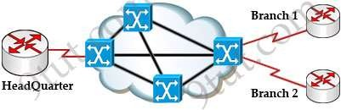

Slide 3
Frame Relay is a high-performance WAN protocol that operates at the physical and Data Link layers of the OSI reference model.

Slide 4
Network providers commonly implement Frame Relay for voice and data as an encapsulation technique, used between LANs over a WAN. Each end user gets a private line (or leased line) to a Frame Relay node. The Frame Relay network handles the transmission over a frequently changing path transparent to all end users.

Slide 5
Frame Relay has become one of the most extensively used WAN protocols, primarily because it is inexpensive compared to dedicated lines. In addition, configuring user equipment in a Frame Relay network is very simple.

Slide 6
Frame Relay connections are created by configuring CPE routers or other devices to communicate with a service provider Frame Relay switch. The service provider configures the Frame Relay switch, which helps keep end-user configuration tasks to a minimum.

Slide 7
Frame Relay has become the most widely used WAN technology in the world. Large enterprises, governments, ISPs, and small businesses use Frame Relay, primarily because of its price and flexibility. As organizations grow and depend more and more on reliable data transport, traditional leased-line solutions are prohibitively expensive.

Slide 8
Frame Relay reduces network costs by using less equipment, less complexity, and an easier implementation. Moreover, Frame Relay provides greater bandwidth, reliability, and resiliency than
private or globalization branch office
leased and the
lines. growth
With increasing of one-to-many
topologies, Frame Relay offers
simpler network architecture and lower cost of ownership.

Slide 9
Using an example of a large enterprise network helps illustrate the benefits of using a Frame Relay WAN. In the example shown in the figure, Span Engineering has five campuses across North America. Like most organizations, Span's bandwidth requirements do not fit "a one size fits all" solution.

Slide 10
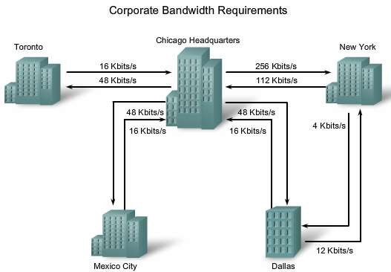

Slide 11
The first thing to consider is the bandwidth requirement of each site. Working out from the headquarters, the Chicago to New York connection requires a maximum speed of 256 kb/s. Three other sites need a maximum speed of 48 kb/s connecting to the headquarters, while the connection between the New York and Dallas branch offices requires only 12 kb/s.

Slide 12
Before Frame Relay became available, Span leased dedicated lines.

Slide 13
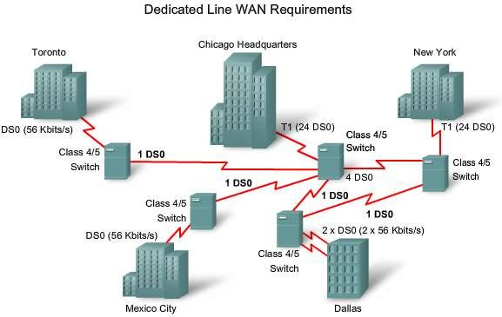

Slide 14
Using leased lines, each Span site is connected through a switch at the local telephone company's central office (CO) through the local loop, and then across the entire network. The Chicago and New York sites each use a dedicated T1 line (equivalent to 24 DS0 channels) to connect to the switch, while other sites use ISDN connections (56 kb/s). Because the Dallas site connects with both New York and Chicago, it has two locally leased lines. The network providers have provided Span with one DS0 between the respective COs, except for the larger pipe connecting Chicago to New York, which has four DS0s.

Slide 15
DS0s are priced differently from region to region, and usually are offered at a fixed price. These lines are truly dedicated in that the network provider reserves that line for Span's own use. There is no sharing, and Span is paying for the end-to-end circuit regardless of how much bandwidth it uses.

Slide 16
A dedicated line provides little practical opportunity for a one-to-many connection without getting more lines from the network
provider. In the example,
almost all through the
communication must flow
corporate headquarters, simply to reduce the cost of additional lines.

Slide 17
If you examine what each site requires in terms of bandwidth, you notice a lack of efficiency:

Slide 18
The leased-line design also
limits flexibility. Unless circuits are already
installed, connecting new sites typically requires new circuit installations and takes considerable time to implement. From a network reliability point of view, imagine the additional costs in money and complexity of adding spare and redundant circuits.

Slide 19
Span's Frame Relay network uses permanent virtual circuits (PVCs). A PVC is the logical path along an originating Frame Relay link, through the network, and along a terminating Frame Relay link to its ultimate destination. Compare this to the physical path used by a dedicated connection. In a network with Frame Relay access, a PVC uniquely defines the path between two endpoints.

Slide 20
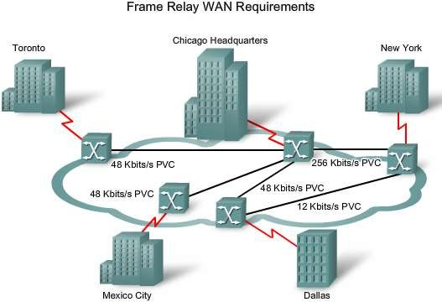

Slide 21
Cost Effectiveness of Frame Relay
Frame Relay is a more cost-effective option for two reasons. First, with dedicated lines, customers pay for an end-to-end connection. That includes the local loop and the network link. With Frame Relay, customers only pay for the local loop, and for the bandwidth they purchase from the network provider. Distance between nodes is not important. While in a dedicated-line model, customers use dedicated lines provided in increments of 64 kb/s, Frame Relay customers can define their virtual circuit needs in far greater granularity, often in increments as small as 4 kb/s.

Slide 22
The second reason for Frame Relay's cost effectiveness is that it shares bandwidth across a larger base of customers. Typically, a network provider can service 40 or more 56 kb/s customers over one T1 circuit. Using dedicated lines would require more DSU/CSUs (one for each line) and more complicated routing and switching. Network providers save because there is less equipment to purchase and maintain.

Slide 23
Cost
The table shows a representative cost comparison for comparable ISDN and Frame Relay connections. While initial costs for Frame Relay are higher than for ISDN, the monthly cost is considerably lower. Frame Relay is easier to manage and configure than ISDN. In addition, customers can increase their bandwidth as their needs grow in the future. Frame Relay customers pay only for the bandwidth they need. With Frame Relay, there are no hourly charges, while ISDN calls are metered and can result in unexpectedly high monthly charges from the telephone company if a full-time connection is maintained.

Slide 24
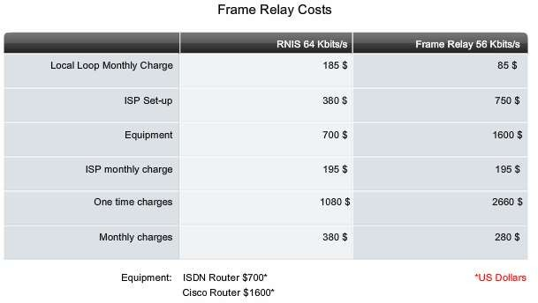

Slide 25
The Frame Relay WAN
In the late 1970s and into the early 1990s, the WAN technology joining the end sites was typically using the X.25 protocol. Now considered a legacy protocol, X.25 was a very popular packet switching technology because it provided a very reliable connection over unreliable cabling infrastructures. It did so by including additional error control and flow control. However, these additional features added overhead to the protocol. Its major application was for processing credit card authorization and for automatic teller machines.

Slide 26
Basic Frame Relay concepts
When you build a WAN, regardless of the transport you choose, there is always a minimum of three basic components, or groups of components, connecting any two sites. Each site needs its own equipment (DTE) to access the telephone company's CO serving the area (DCE). The third component sits in the middle, joining the two access points. In the figure, this is the portion supplied by the Frame Relay backbone.

Slide 27
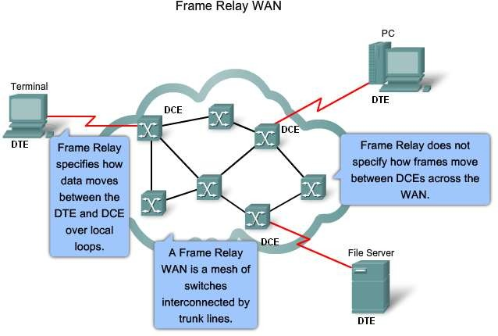

Slide 28
Frame
Relay has lower overhead than X.25
because it has fewer capabilities. For example, Frame Relay does not provide error correction, modern WAN facilities offer more reliable connection services and a higher degree of reliability than older facilities. The Frame Relay node simply drops packets without notification when it detects errors. Any necessary error correction, such as retransmission of data, is left to the endpoints. This makes propagation from customer end to customer end through the network very fast.

Slide 29
Frame Relay handles volume and speed efficiently by combining the necessary functions of the data link and Network layers into one simple protocol. As a data link protocol, Frame Relay provides access to a network, delimits and delivers frames in proper order, and recognizes transmission errors through a standard Cyclic Redundancy Check. As a network protocol, Frame Relay provides multiple logical connections over a single physical circuit and allows the network to route data over those connections to its intended destinations.

Slide 30
Frame Relay operates between an end-user device, such as a LAN bridge or router, and a network. The network itself can use any transmission method that is compatible with the speed and efficiency that Frame Relay applications require. Some networks use Frame Relay itself, but others use digital
circuit switching or ATM cell
relay circuit- by the
systems. The figure shows a
switching backbone as indicated Class 4/5 switches.

Slide 31
Frame Relay Operation
The connection between a DTE device and a DCE device consists of both a Physical layer component and a link layer component:

Slide 32
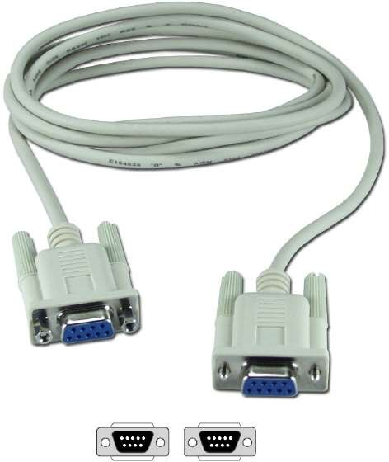
The physical
component
defines the and
mechanical, electrical,
functional,
procedural specifications for the connection
between the devices. One
of the most
commonly used Physical layer interface specifications is the RS-232 specification.
•

Slide 34
The link
layer component defines the
protocol that establishes the connection between the DTE device, such as a router, and the DCE device, such as a switch.

Slide 35
When carriers use Frame Relay to interconnect LANs, a router on each LAN is the DTE. A serial connection, such as a T1/E1 leased line, connects the router to the Frame Relay switch of the carrier at the nearest point- of-presence (POP) for the carrier. The Frame Relay switch is a DCE device. Network switches move frames from one DTE across the network and deliver frames to other DTEs by way of DCEs. The computing equipment uses a Frame Relay access device (FRAD) as the DTE. The FRAD is sometimes referred to as a Frame Relay assembler/dissembler and is a dedicated appliance or a router configured to support Frame Relay. It is located on the customer's premises and connects to a switch port on the service provider's network. In turn, the service provider interconnects the Frame Relay switches.

